Slide 1



Lecture 3a
Convolutional Layers
Master in Big Data Solutions 2020-2021 - Artificial Intelligence
Xavier Giró
xavier.giro@bts.tech

Slide 2





Acknowledgements
Míriam Bellver
miriam.bellver@bsc.edu
PhD
Universitat Politècnica de Catalunya
Barcelona Supercomputing Center
Kevin McGuinness
kevin.mcguinness@dcu.ie
Research Fellow
Insight Centre for Data Analytics
Dublin City University

Slide 3
Today’s objective
Distinguish between a fully connected vs a convolutional neural network.
Value the translation invariance properties of convolutional filters.
Understand the computational efficiency of convolutional vs fully connected layers.

Slide 4
Outline
Limitations of Multi-Layer Perceptrons
Convolutional Layers
Properties of the Convolutions

Slide 5
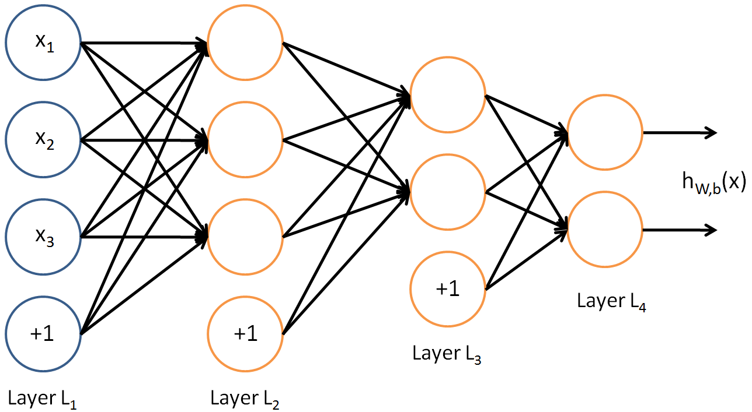
Limitations of MLPs
Multi-Layer Perceptrons (MLPs) are deep learning networks with several fully connected layers.
Network with two hidden layers and two outputs
Figure Credit

Slide 6
Limitations of MLPs
Multi-Layer Perceptrons are deep learning networks with several fully connected layers.
Network with two hidden layers and two outputs
Each layer is connected to all its inputs
Feasible when dealing with certain data, even small image, but …
Figure Credit

Slide 7
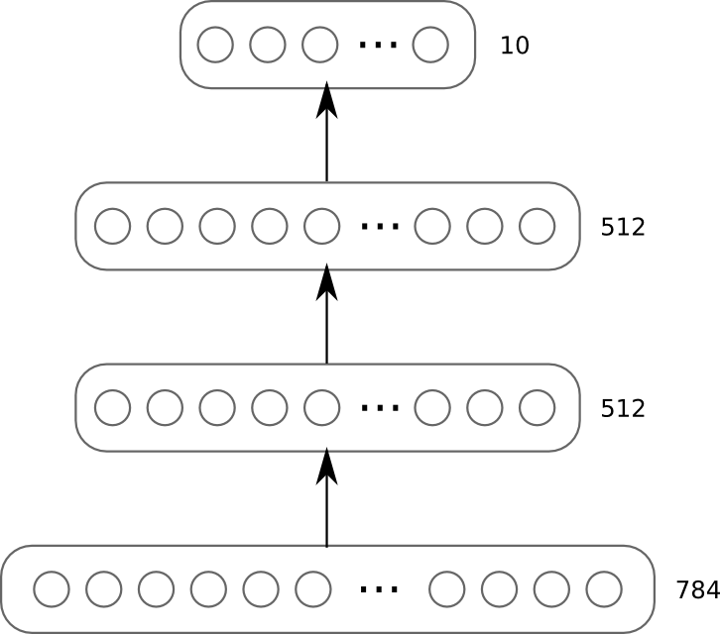
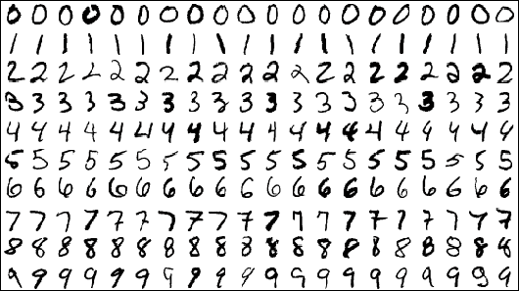
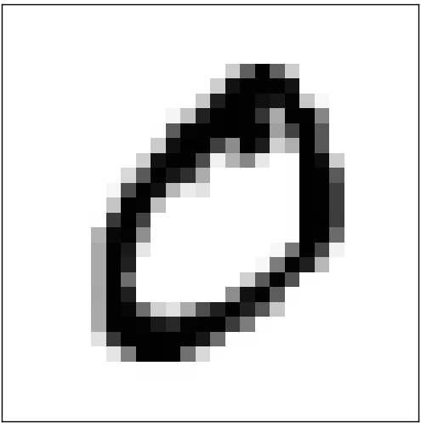
Limitations of MLPs
28
28

Slide 8
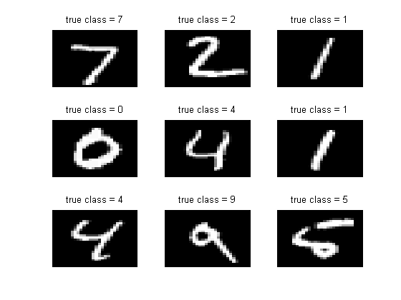
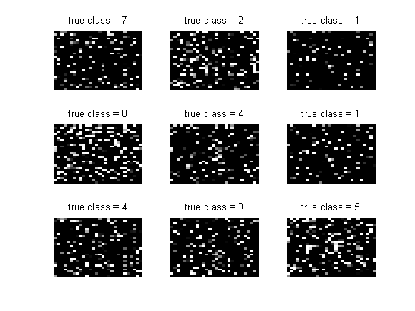
Limitations of MLPs
Can you recognize the digits on the left ? And their transformation with a fixed permutation on the right ? Why ?
Permute

Slide 9
Limitations of MLPs
What would happen if we trained an MLP on a version of MNIST dataset in which all pixels moved with a fixed permutation across all images ?
Permute

Slide 10
Limitations of MLPs
What’s going on?
Fully connected layers assume no spatial neighbourhood relationships
Maybe we can do better if we somehow embed these structural relationships into the algorithm…
Permute

Slide 11
Limitations of MLPs
Layer | #Weights | #Biases | Total
1 | 784 x 512 | 512 | 401,920
2 | 512 x 512 | 512 | 262,656
3 | 512 x 10 | 10 | 5,130
 |  |  | 669,706
28
28

Slide 12

Limitations of MLPs
What challenge do you foresee if instead of classifying 28x28 images with an MLP, we try to classify full resolution RGB (3 channels) images ?
28
28

Slide 13
Limitations of MLPs
What challenge do you foresee if instead of classifying 28x28 images with an MLP, we try to classify full resolution RGB (3 channels) images ?
In this case learning features on the entire input is computationally very expensive. MLP networks are very slow when training them, and also when doing inference in these cases.

Slide 14
Outline
Limitations of Multi-Layer Perceptrons
Convolutional Layers
1D convolutions
2D convolutions
3D convolutions
Properties of the Convolutions

Slide 15


1D convolution
Figures: Tinos (Wikimedia)

Slide 16
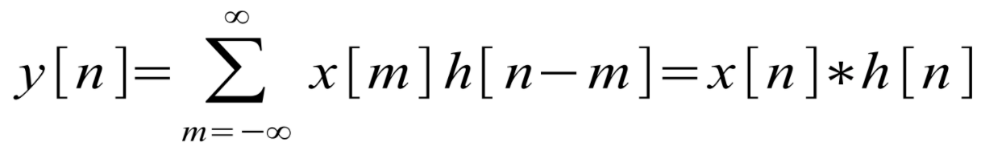
1D convolution
 | .
Input signal x[m]
 | 1 | 5 | 0 | 2 | 8 | 1
dot product
Kernel/filter h[n-m]
-1 | 2 | -1
=
Output signal
y[n]
 | 9

Slide 17
1D convolution
 | .
Input signal x[m]
 | 1 | 5 | 0 | 2 | 8 | 1
dot product
Kernel/filter h[n-m]
-1 | 2 | -1
=
Output signal
y[n]
 | 9 | -7

Slide 18
1D convolution
 | .
Input signal x[m]
 | 1 | 5 | 0 | 2 | 8 | 1
dot product
Kernel/filter h[n-m]
-1 | 2 | -1
=
Output signal
y[n]
 | 9 | -7 | -4

Slide 19
1D convolution
 | .
Input signal x[m]
 | 1 | 5 | 0 | 2 | 8 | 1
dot product
Kernel/filter h[n-m]
-1 | 2 | -1
=
Output signal
y[n]
 | 9 | -7 | -4 | 13

Slide 20
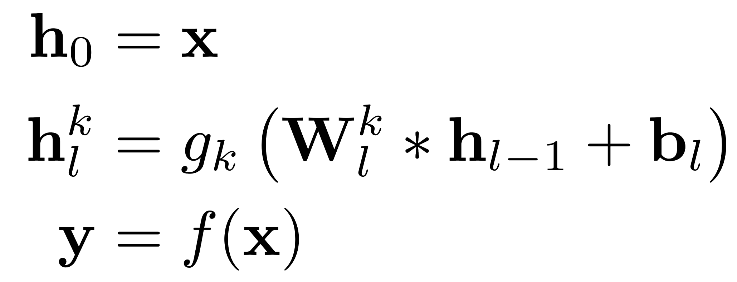
Convolutional Network
Input data
Convolutional Layer l
(k^{th} channel)
Output data
Convolutional operator

Slide 21
1D convolution
Provide general formula to compute the length of the output sequence (L_{y}) given the size of the kernel (K) of odd size and length of the input sequence (L_{x}).
 |  | . | . | . | .
Input signal x[m]
 | 1 | 5 | 0 | 2 | 8 | 1
dot product
Kernel/filter h[n-m]
-1 | 2 | -1
=
Output signal
y[n]
 | 9 | -7 | -4 | 13

Slide 22
1D convolution
Provide general formula to compute the length of the output sequence (L_{y}) given the size of the kernel (K) of odd size and length of the input sequence (L_{x}).
 | X | . | . | . | . | X
L_{y}=L_{x} if we did not miss the samples X.
There are a total of K-1 samples X.
So,
 | 1 | 5 | 0 | 2 | 8 | 1
-1 | 2 | -1
-1 | 2 | -1
L_{y} = L_{x}-(K-1)
=
 | 9 | -7 | -4 | 13
In this example (L_{x}=6, K=3):
L_{y} = 6-(3-1)=6-2=4

Slide 23
1D convolution with Zero Padding
zero padding (P) =1
Input signal x[m]
0 | 1 | 5 | 0 | 2 | 8 | 1 | 0
Kernel/filter h[n-m]
-1 | 2 | -1
=
Output signal
y[n]
-3
Zero Padding: Adding zeros at the limits of the input signal, the output signal dimension as the input signal

Slide 24
1D convolution with Zero Padding
zero padding (P) =1
Input signal x[m]
0 | 1 | 5 | 0 | 2 | 8 | 1 | 0
Kernel/filter h[n-m]
-1 | 2 | -1
Output signal
y[n]
-3 | 9 | -7 | -4 | 13 | -6
Zero Padding: Adding zeros at the limits of the input signal, the output signal dimension as the input signal

Slide 25
1D convolution with Zero Padding
Provide general formula to compute the length of the output sequence (L_{y}) given the size of the kernel (K) of odd size, zero padding (P), and length of the input sequence (L_{x}).
Input signal x[m]
0 | 1 | 5 | 0 | 2 | 8 | 1 | 0
Kernel/filter h[n-m]
-1 | 2 | -1
Output signal
y[n]
-3 | 9 | -7 | -4 | 13 | -6

Slide 26
1D convolution with Zero Padding
Provide general formula to compute the length of the output sequence (L_{y}) given the size of the kernel (K) of odd size, zero padding (P), and length of the input sequence (L_{x}).
Starting from the non-padding formula
L_{y} = L_{x}-(K-1),
we increase the amount of dot products by adding P=(K-1)/2 zeros at each of the two sides:
L_{y} = L_{x}-(K-1)+2P=
= L_{x}- (K-1) + 2(K-1)/2 =
= L_{x}- (K-1) + (K-1)= L_{x}
Input signal x[m]
0 | 1 | 5 | 0 | 2 | 8 | 1 | 0
Kernel/filter h[n-m]
-1 | 2 | -1
Output signal
y[n]
-3 | 9 | -7 | -4 | 13 | -6

Slide 27
1D causal convolution with Zero Padding
How could we modify the presented padding scheme to make the system causal ?
Causal system: The output at each time step depends from the previous and/or present inputs (never from future inputs).
Input signal x[m]
0 | 1 | 5 | 0 | 2 | 8 | 1 | 0
Kernel/filter h[n-m]
-1 | 2 | -1
Output signal
y[n]
-3 | 9 | -7 | -4
This scheme is not causal because y[n] depends from x[n+1].

Slide 28
1D causal convolution with Zero Padding
How could we modify the presented padding scheme to make the system causal ?
Input signal x[m]
0 | 0 | 1 | 5 | 0 | 2 | 8 | 1
The convolution becomes causal by padding left the sequence with
(K - 1) zeros
Kernel/filter h[n-m]
-1 | 2 | -1
Output signal
y[n]
-1

Slide 29
1D convolution: Stride
Convolution stride: Size of the each step of the convolutional filter.
As a result, the length of the output sequence decreases by the stride factor.
Input signal x[m]
0 | 1 | 5 | 0 | 2 | 8 | 1 | 0
Kernel/filter h[n-m]
-1 | 2 | -1
Stride (S) = 2
Output signal
y[n]
-3

Slide 30
1D convolution: Stride
Convolution stride: Size of the each step of the convolutional filter.
As a result, the length of the output sequence decreases by the stride factor.
Input signal x[m]
0 | 1 | 5 | 0 | 2 | 8 | 1 | 0
Kernel/filter h[n-m]
-1 | 2 | -1
Stride (S) = 2
Output signal
y[n]
-3 |  | -7

Slide 31
1D convolution: Stride
Convolution stride: Size of the each step of the convolutional filter.
As a result, the length of the output sequence decreases by the stride factor.
Input signal x[m]
0 | 1 | 5 | 0 | 2 | 8 | 1 | 0
Kernel/filter h[n-m]
-1 | 2 | -1
Stride (S) = 2
Output signal
y[n]
-3 |  | -7 |  | 13

Slide 32
1D convolution: Stride
Provide general formula to compute the length of the output sequence (L_{y}) given the size of the kernel (K) of odd size, zero padding (P), stride (S), and length of the input even sequence (L_{x}).
Input signal x[m]
0 | 1 | 5 | 0 | 2 | 8 | 1 | 0
Kernel/filter h[n-m]
-1 | 2 | -1
Output signal
y[n]
-3 |  | -7 |  | 13

Slide 33
1D convolution: Stride
Provide general formula to compute the length of the output sequence (L_{y}) given the size of the kernel (K) of odd size, zero padding (P), stride (S), and length of the input even sequence (L_{x}).
Starting from the formula with padding
L_{y} = L_{x}
now we are reducing the amount of positions by dividing all possible dot product by S.
L_{y} = L_{x}/S
In this example:
L_{y} = 6/2 = 3
Input signal x[m]
0 | 1 | 5 | 0 | 2 | 8 | 1 | 0
Kernel/filter h[n-m]
-1 | 2 | -1
Output signal
y[n]
-3 |  | -7 |  | 13

Slide 34
Study case: Convolutions for Language
Let’s say we have a sequence of 100 dimensional word embeddings.
100 dim
hi
there
,
how
are
you
doing
?
arrange
in 2D
sequence length = 8
100 dim
sequence length = 8
Slide: Santiago Pascual (UPC DLAI 2018)

Slide 35
Study case: Convolutions for Language
We can apply a 1D convolutional activation over the 2D matrix: for an arbitrary kernel of width=3
K1
Each 1D convolutional kernel is a 2D matrix of size (3, 100)
100 dim
100 dim
sequence length = 8
Slide: Santiago Pascual (UPC DLAI 2018)

Slide 36
Study case: Convolutions for Language
Note: We depict just depth=1 for simplicity, but actual depth is 100.
1 2 3 4 5 6 7 8
w1 w2 w3
L_{y} = L_{x}-(K-1)= 8 - (3-1) = 6
The output tensor is (6,1).
w1 w2 w3
w1 w2 w3
w1 w2 w3
w1 w2 w3
w1 w2 w3
1 2 3 4 5 6
Slide: Santiago Pascual (UPC DLAI 2018)

Slide 37
Study case: Convolutions for Language
When can add zero padding on both sides of the sequence:
0
1 2 3 4 5 6 7 8
0
w1 w2 w3
w1 w2 w3
L_{y} = L_{x}-K+1+2P = 8-3+1+2=8
The output tensor is (8,1).
w1 w2 w3
w1 w2 w3
w1 w2 w3
w1 w2 w3
w1 w2 w3
w1 w2 w3
1 2 3 4 5 6 7 8
Slide: Santiago Pascual (UPC DLAI 2018)

Slide 38
Outline
Limitations of Multi-Layer Perceptrons
Convolutional Layers
1D convolutions
2D convolutions
3D convolutions
Properties of the Convolutions

Slide 39
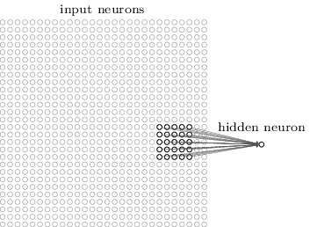
2D convolution

Slide 40
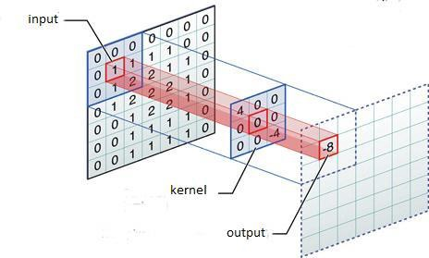
2D convolution
Image credit: Performing Convolution Operations (developer.apple.com)

Slide 41


2D convolution
What is the difference between the two examples ?
OUTPUT
INPUT
Padding ❌
Strides ✔
Padding ✔
Strides ✔
Vincent Dumoulin, Francesco Visin, “A guide to convolution arithmetic for deep learning”, arXiv 2016. [code]

Slide 42

2D convolution
What is the difference between the two examples ?
OUTPUT
INPUT
Padding ✔
Strides ❌
Padding ✔
Strides ✔
Vincent Dumoulin, Francesco Visin, “A guide to convolution arithmetic for deep learning”, arXiv 2016. [code]

Slide 43
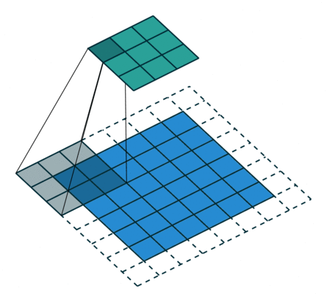
2D convolution
What is the difference between the two examples ?
OUTPUT
INPUT
Input: 6x6
Input: 5x5
Vincent Dumoulin, Francesco Visin, “A guide to convolution arithmetic for deep learning”, arXiv 2016. [code]

Slide 44

2D convolution
Image credit: Deep learning Tutorial (Stanford University)

Slide 45
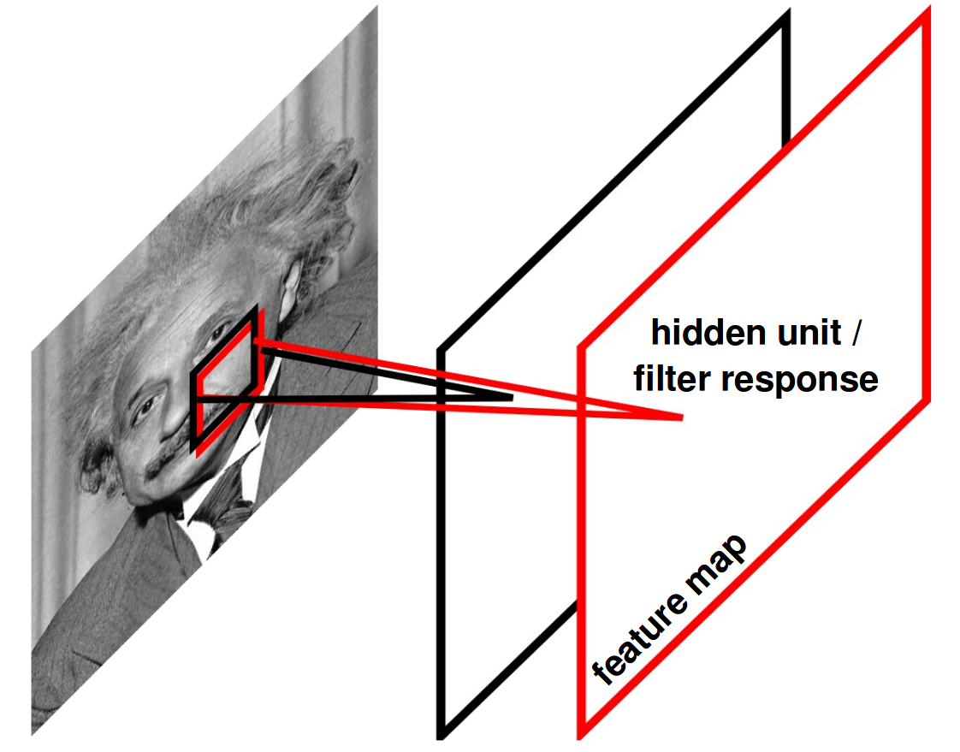
Feature or Activation Maps
Each 2D filter produces a 2D feature or activation map.
One convolutional layer will typically contain multiple 2D filters.
The amount of convolutional filters, which determines the amount of output channel, is a choice of the neural architect.
Figure Credit: Ranzatto

Slide 46

Feature or Activation Maps
Figures Credit, NYU course

Slide 47
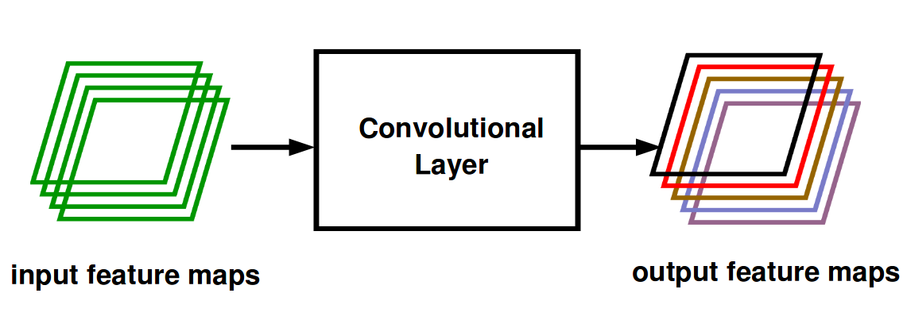
Feature or Activation Maps
A convolutional layer can be understood as a module that transforms some feature maps to other feature maps, which learn higher-abstract concepts
Figure Credit: Ranzatto

Slide 48
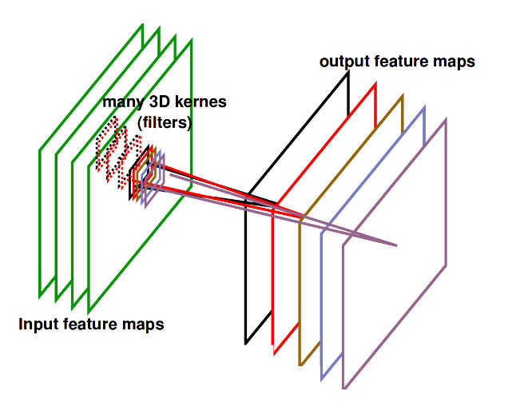
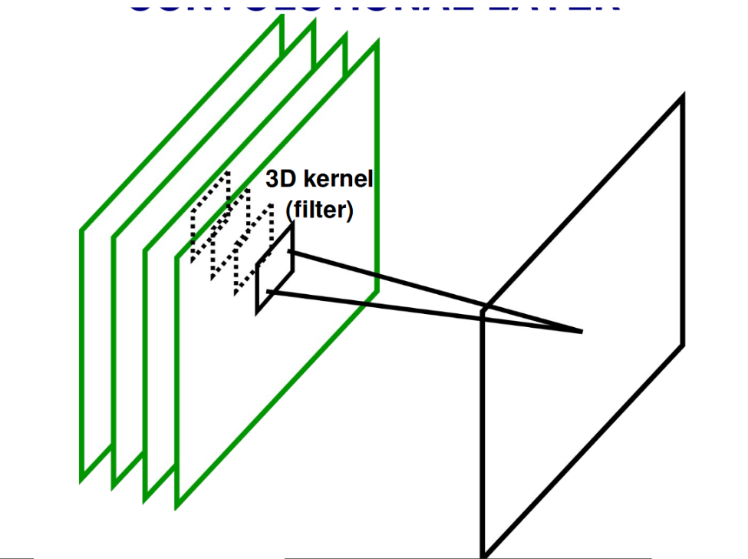
Feature or Activation Maps
Notice that convolutional filters must match the depth dimension of the input tensor.
Many feature maps
filter of depth=4
output feature map
Figure Credit: Ranzatto

Slide 49
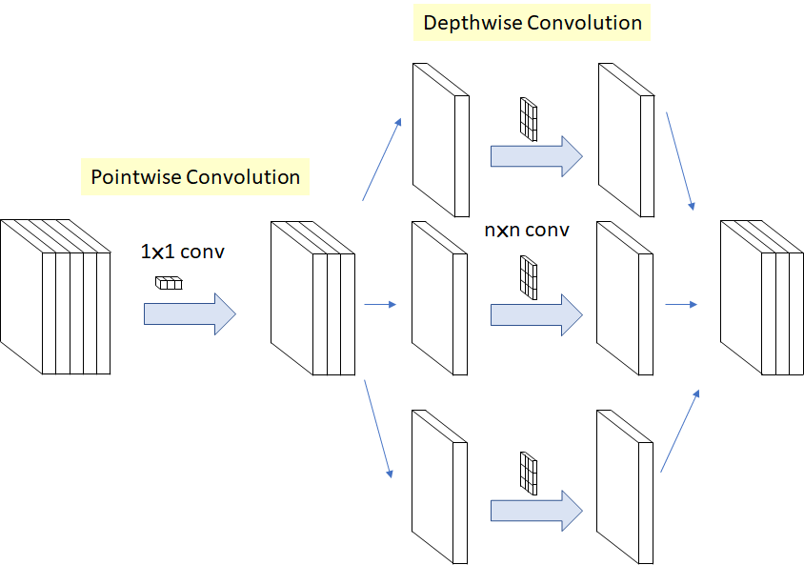
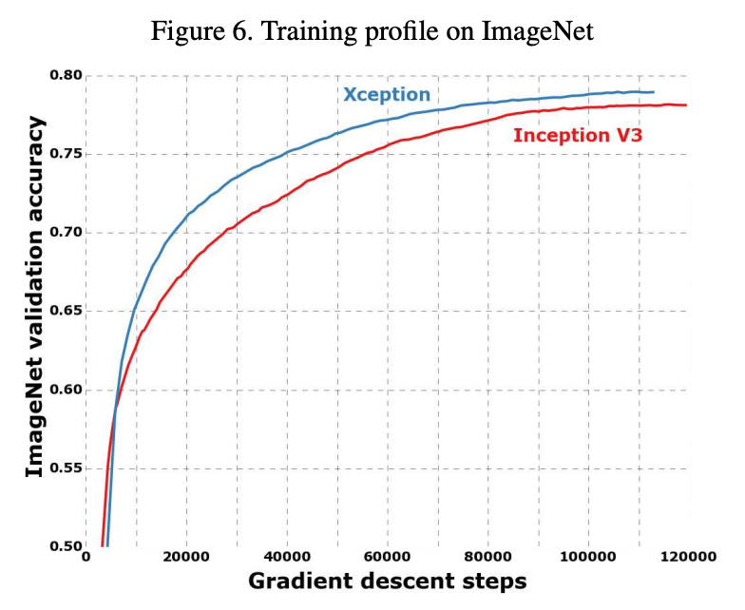
Depthwise Separable 2D (group) Convolutions
Depth-wise (in channels) separable convolutions.
Figure: Sik-Ho Tsang
#XCeption Chollet, François. "Xception: Deep learning with depthwise separable convolutions." CVPR 2017.

Slide 50
Outline
Limitations of Multi-Layer Perceptrons
Convolutional Layers
1D convolutions
2D convolutions
3D convolutions
Properties of the Convolutions

Slide 51
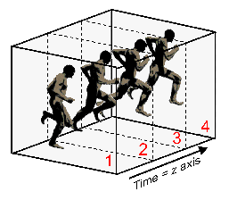
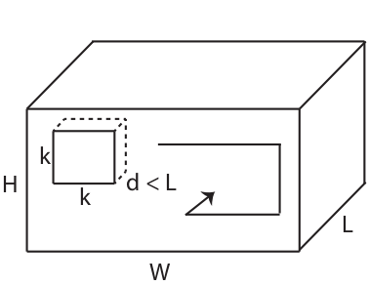
3D Convolutions
We can add an extra dimension to standard 2D CNN filters:
A grayscale video clip may be represented by a tensor of size H x W x L.
A 3D conv filter for the 1st conv layer may be of size k x k x d
time
#C3D Tran, Du, Lubomir Bourdev, Rob Fergus, Lorenzo Torresani, and Manohar Paluri. "Learning spatiotemporal features with 3D convolutional networks" ICCV 2015

Slide 52

3D Convolutions
Limitation:
How can we use pre-trained C2D filters to initialize C3D training ?

Slide 53
Inflated 3D Convolutions (I3D)
We can adapt C2D filters to C3D by replicating them along the temporal axis (and scaling its values by 1/d).
C2D filter
I3D filter
inflation
k x k
k x k x d
Filter inflation allows reusing C2D pre-trained filters (eg. from ImageNet) to initialize C3D filters.
#I3D Carreira, J., & Zisserman, A. . Quo vadis, action recognition? A new model and the kinetics dataset. CVPR 2017. [code]

Slide 54
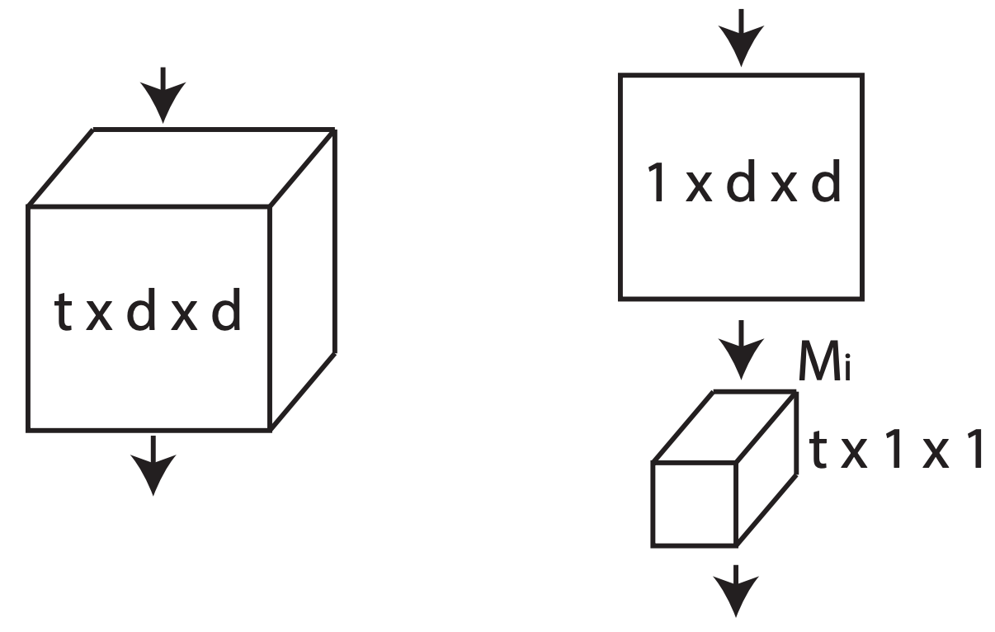
2D+1 Convolutions
Splits the computation into a spatial 2D convolution followed by a temporal 1D convolution:. In the case of an input of a single feature channel:
C3D
C(2+1)D
Number of 2D filters
#R(2+1)D Tran, Du, Heng Wang, Lorenzo Torresani, Jamie Ray, Yann LeCun, and Manohar Paluri. "A closer look at spatiotemporal convolutions for action recognition." CVPR 2018. [code]

Slide 55
Outline
Limitations of Multi-Layer Perceptrons
Convolutional Layers
Properties of the Convolutions
Translation invariance
Computational efficiency

Slide 56
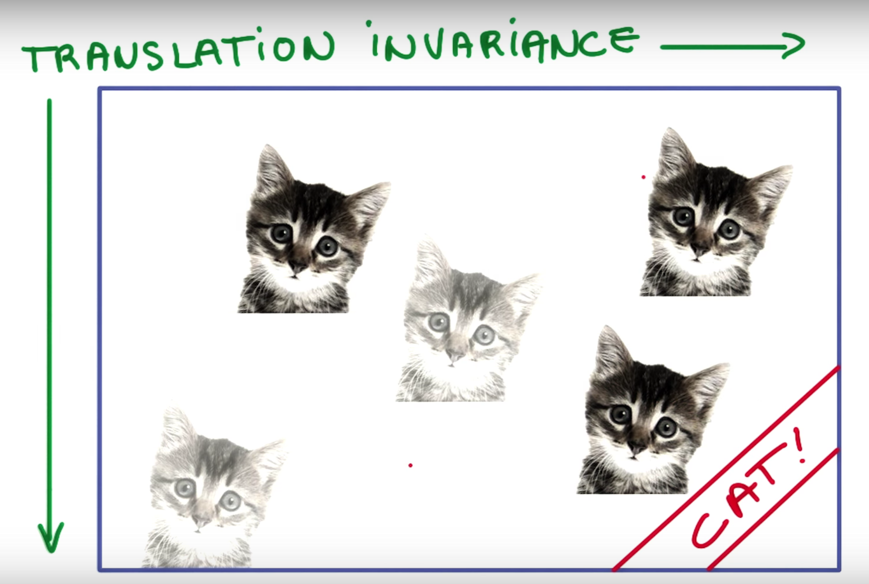
Translation invariance
Translation (shift) invariance: if a feature is good for one part, it should be good for others too.
Figure: Intro to TensorFlow for Deep Learning (Udacity)

Slide 57

Translation invariance
Smaller model: Parameters are shared across these convolutional kernels (translation invariance)

Slide 58
Outline
Limitations of Multi-Layer Perceptrons
Convolutional Layers
Properties of the Convolutions
Translation invariance
Computational efficiency

Slide 59
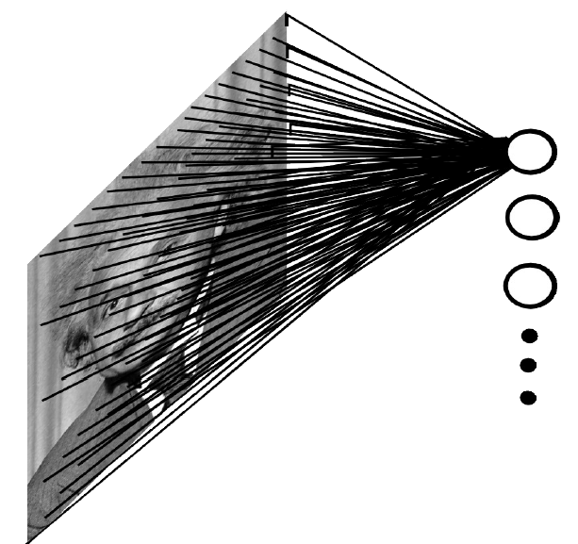
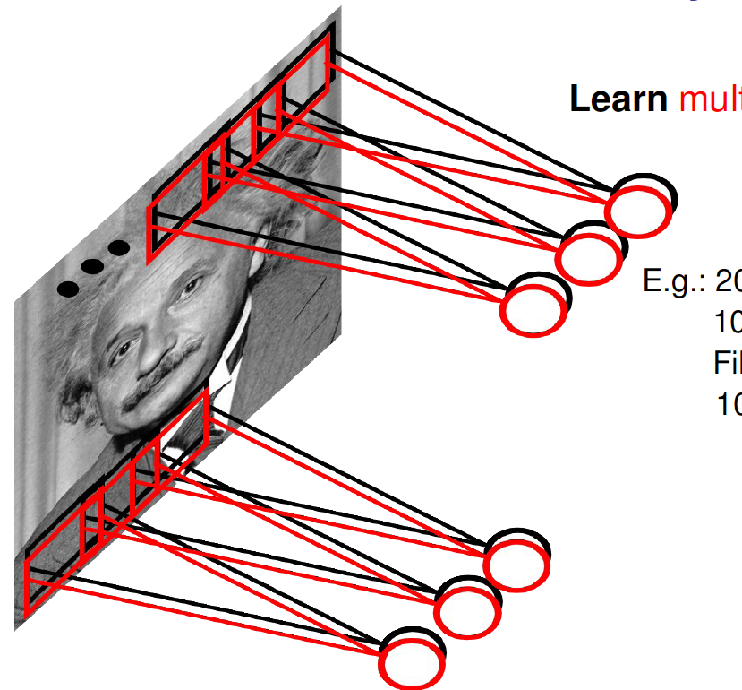
Properties
Local: only depend on a small part of the previous layer, not the whole.
Fully Connected layer (FC)
Convolutional layer (Conv)
Figures: Ranzatto

Slide 60
Properties
Input(x): 1000x1000 grayscale image
Fully connected neurons
100 fully connected neurons
10⁸ weights
Convolutional neurons
100 convolutional neurons of 10x10
10⁴ weights
(*) biases not included
Figures Credit: Ranzatto

Slide 61
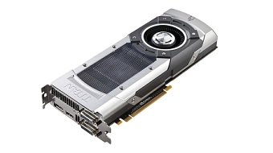
Properties
(Far) Less computation than a fully connected approach:
Instead of a big matrix multiplication on the whole image, compute in parallel a smaller amount of little matrix multiplications.

Slide 62
Outline
Limitations of Multi-Layer Perceptrons
Convolutional Layers
Properties of the Convolutions

Slide 63


